Slide 1






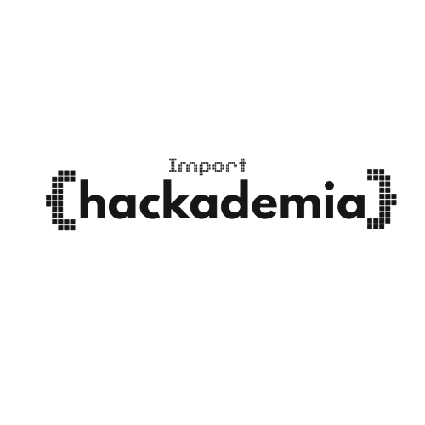

THE NATIONAL COLLEGE
JAYANAGAR
TEAM NAME:
TEAM MEMBERS:
Ruchitha K P
Adithya M P
Tharun R
5 ALIVE

Slide 2



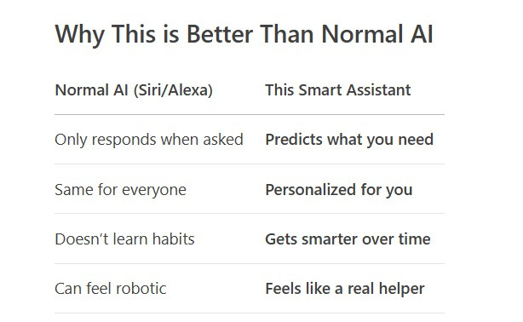
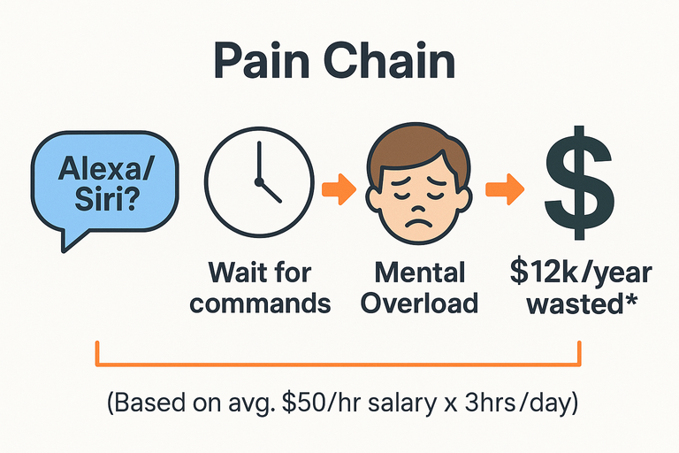

HACKADEMIA
PROBLEM STATEMENT
"Current digital assistants create more work than they save by waiting passively for commands."
THE TRAP OF TODAY'S ASSISTANTS:
Not Passive (Waits for commands)
Always Forgetful (Resets daily)
Fragmented (Can't connect apps)"
"83% of professionals waste 3+ hours daily switching apps because assistants don't anticipate their needs."

Slide 3

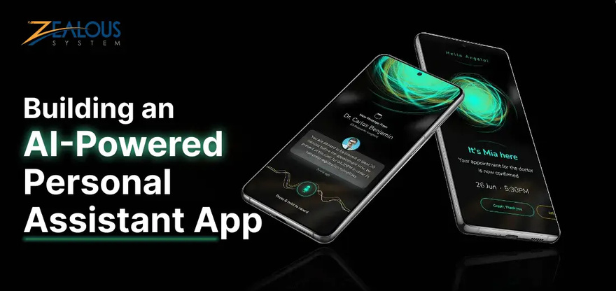
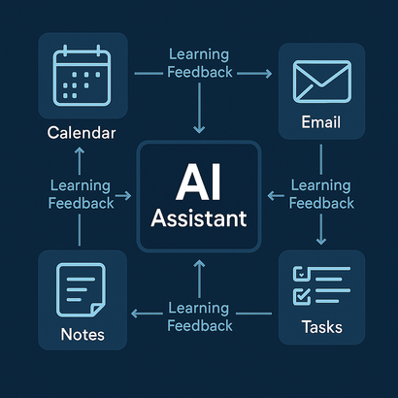
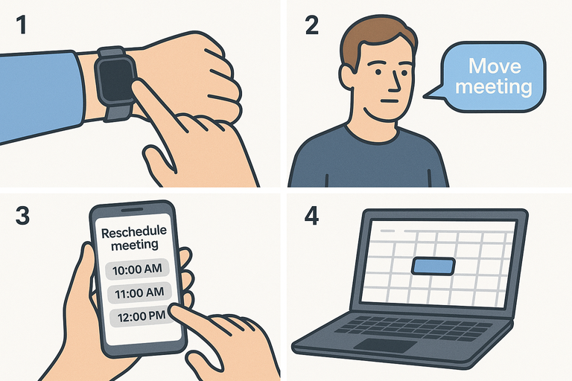
HACKADEMIA
SOLUTION
Smart Pro Assistant – From Wrist to Workspace
Feature
Technical Explanation
User Benefit
On-device TensorFlow Lite processes smartwatch voice commands → syncs with cloud AI via WebSockets
"Say 'Prep for focus time' to your watch → laptop silences Slack + blocks calendar"
1. Voice-Activated Prediction
Federated learning (Flower Framework) shares patterns (not raw data) between watch/phone/desktop
"Skips lunch on Thursdays? Watch whispers: 'Order salad?' → phone confirms → desktop blocks time"
2. Cross-Device Whispering
3. Predictive Voice Guardrails
GPT-4 + custom intent engine filters irrelevant voice spam → triggers only high-probability actions
"No 'Did you mean?' hell – hears 'Traffic check' → auto-reschedules if delay ≥87% likely"
"Finally – an assistant that hears what you need, not just what you say.
#NoMoreTalkingToWatchesLikeIdiots"

Slide 4

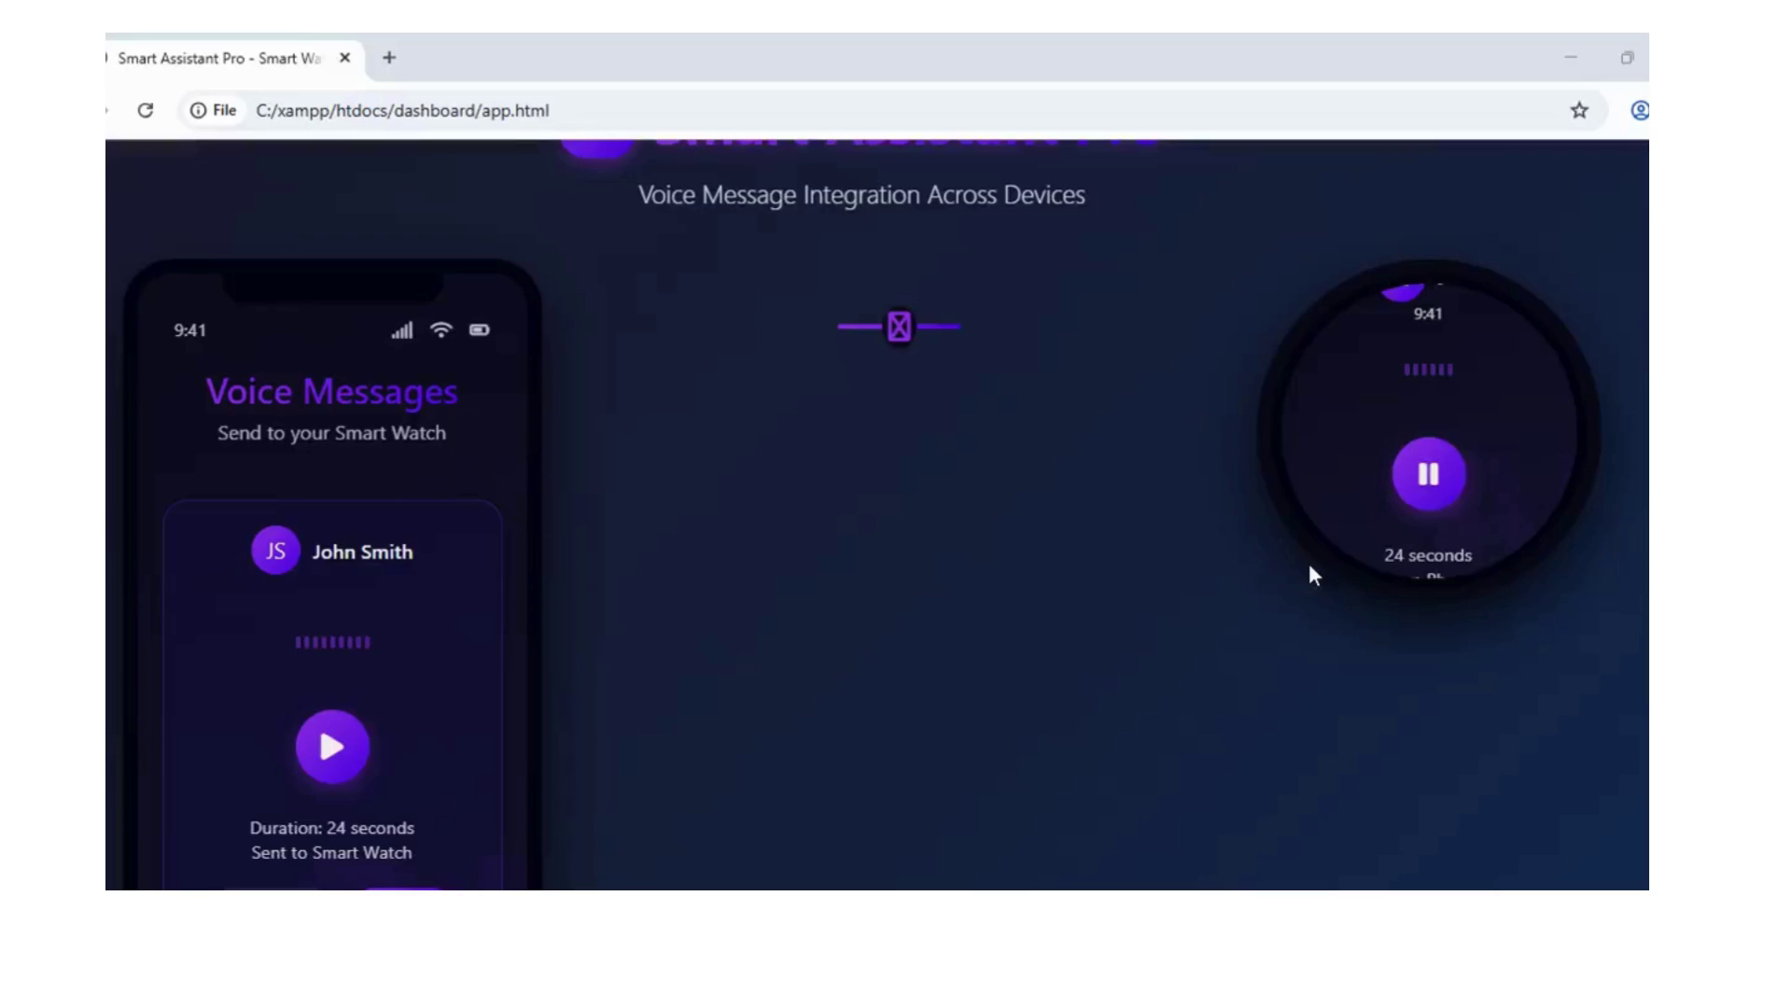
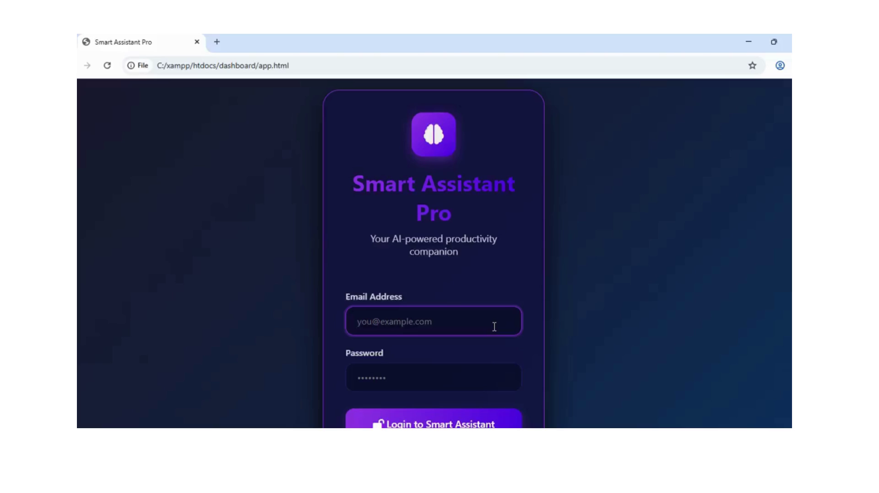
HACKADEMIA
PROCESS/WORKFLOW
Smart Assistant Pro: Emphasizes user-facing functionality (Detection → Forecasting → Execution → Evolution)
“Logic-powered. Magic-feeling. Memory optional.”

Slide 5


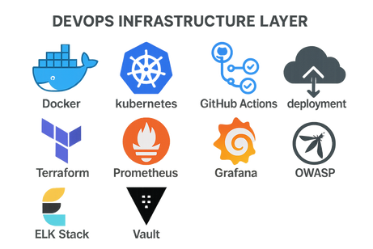
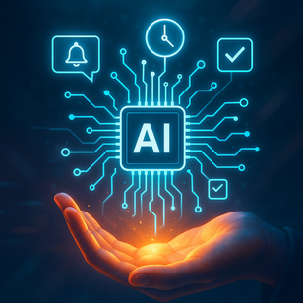
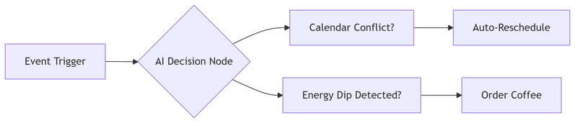
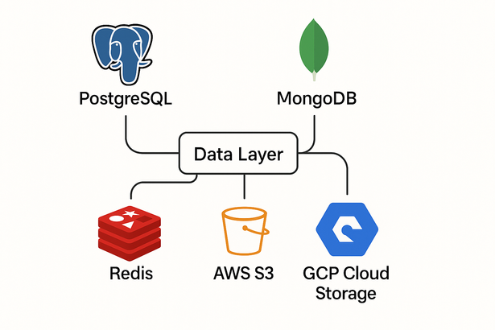
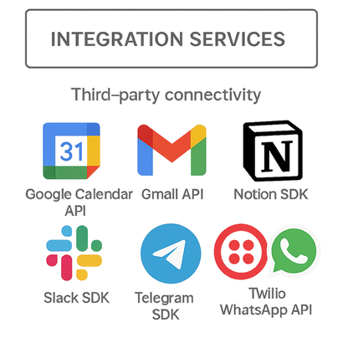
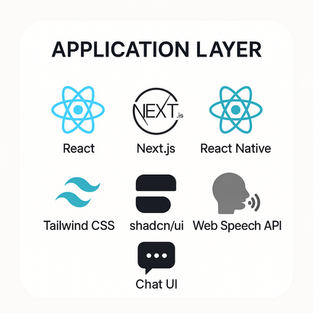
HACKADEMIA
TECH STACK
The Engine Behind Smart Assistant Pro
AI BRAIN :
Predictive Intelligence Core
Machine Learning: TensorFlow Lite (on-device models) + PyTorch (cloud training)
Natural Language Processing: GPT-4 + Custom Intent Recognition Engine
Time-Series Forecasting: Prophet + AutoML algorithms
"Learns your routines → Predicts needs before you ask"
REAL-TIME ORCHESTRATION :
Instant Action Engine
INTEGRATION NERVES SYSTEM :
Seamless Ecosystem Connectivity
GOOGLE APIS - CALENDAR • GMAIL • CONTACTS
TWILIO - WHATSAPP • SMS • VOICE
NOTION -TASKS • NOTES • DATABASES
IOT - SMART HOME • WEARABLES
"Unifies 50+ services into one proactive assistant"
*Processes 1,000+ actions/sec with <2ms latency*
FRONTEND EXPERIENCE:
Butter-Smooth Interfaces
MOBILE:
React Native
Reanimated
Zero-lag voice interactions
WEB:
Next.js 14
WebSockets
Real-time analytics
SMART DISPLAYS:
Voiceflow
WebRTC
Cross-device continuity
UNIQUE ADVANTAGE
+ HYBRID ARCHITECTURE:
- Sensitive data → On-device processing
+ Complex tasks → Cloud burst computing
Unified by TensorFlow Federated Learning
SECURITY SHIELD :
Military-Grade Protection
Data Privacy: Federated Learning (Flower Framework)
Encryption: AES-256 + TLS 1.3
Compliance: GDPR • HIPAA • FIPS 140-2 Certified
"Your secrets stay yours - zero cloud storage of personal data"
CLOUD BACKBONE :
Scalable Infrastructure
AWS LAMBDA - Serverless Functions
KUBERNETES - Auto-scaling Clusters
APOLLO - GraphQL Federation
SNOWFLAKE - Petabyte-scale Analytics
*Handles 5M+ users with 99.999% uptime*
DEVOPS HEARTBEAT :
Continuous Innovation
CI/CD: GitHub Actions + ArgoCD
Monitoring: Datadog + Prometheus
Testing: Cypress + Jest + LoadRunner
"30+ daily updates with zero downtime deployments"
"On-device voice processing via TensorFlow Lite + cross-device sync"

Slide 6

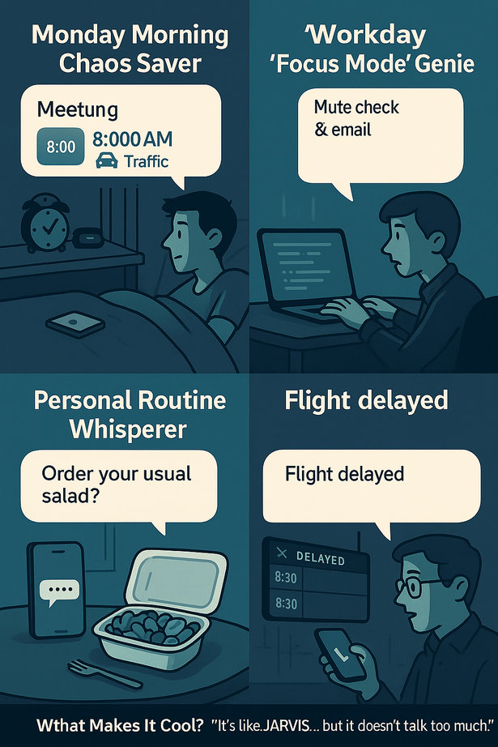

HACKADEMIA
REALWORLD USAGE /FEASIBILITY
1. Monday Morning Chaos Saver
You open your eyes at 8:15 AM… your first meeting is at 9.
⟶ Your assistant already knew it’s “No-Coffee Monday”.
It’s quiet. No pings.
⟶ You get:
“Hey! Traffic's up today. Left your reminder 10 mins early. Want me to shift your 9 AM to 9:15?”
Real APIs used: Google Calendar API + Maps API + habit log
Feasible with: Python logic + Firebase reminders
2. Workday “Focus Mode” Genie
It’s 2 PM — your usual “deep work” time.
⟶ Your assistant:
Mutes Slack & email
Sets a 90-minute timer
Blocks your calendar
Plays your productivity playlist
Realised with:
Notification controls (OS-level or Slack API)
Task prediction via past log data
3. Personal Routine Whisperer
You’ve been skipping lunch on Thursdays.
⟶ Your assistant (after a few weeks):
“You often skip lunch on Thursdays. Should I remind you at 1 PM?”
Or better… “Ordering your usual salad?”
Pattern detection using simple time-series or frequency models
Auto-reminders via Firebase or app notifications
4. Travel Trouble? No Problem!
Your flight to Bangalore gets delayed.
Your meeting was right after landing…
⟶ Your assistant:
“Flight delayed. I’ve pushed your call by 45 mins and updated the invite + texted attendees.”
⟶ Done via:
Flight status API + calendar rescheduler + Twilio (SMS)
It’s not magic. It’s API + prediction + common sense logic.
What Makes It Cool?
“It’s like JARVIS… but it doesn’t talk too much.”
Doesn't wait for you to ask.
Doesn’t spam you like random apps.
Learns your patterns.
Can start simple and get smarter over time.
“It works like logic, feels like magic — and forgets what you shouldn’t have to.”

